Slide 1
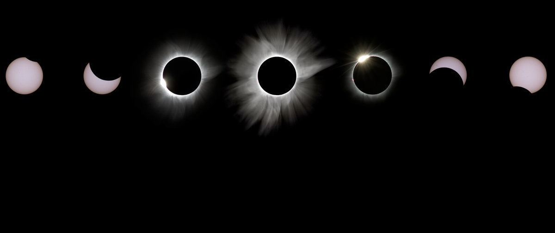
Aug 21
5 pm
6 pm
Aug 21
Today
17:18
17:43
18:05
18:28
18:47
Salem, Oregon
Casper, Wyoming
Sabetha, Kansas
Nashville, Tennessee
Charleston, South Carolina
17:33
18:03
18:21
18:43
Idaho Falls, Idaho
Lincoln, Nebraska
Carbondale, Illinois
Columbia, South Carolina
18:37
Clayton, Georgia
18:26
Hopkinsville, Kentuky
18:14
Jefferson City, Missouri

Slide 2
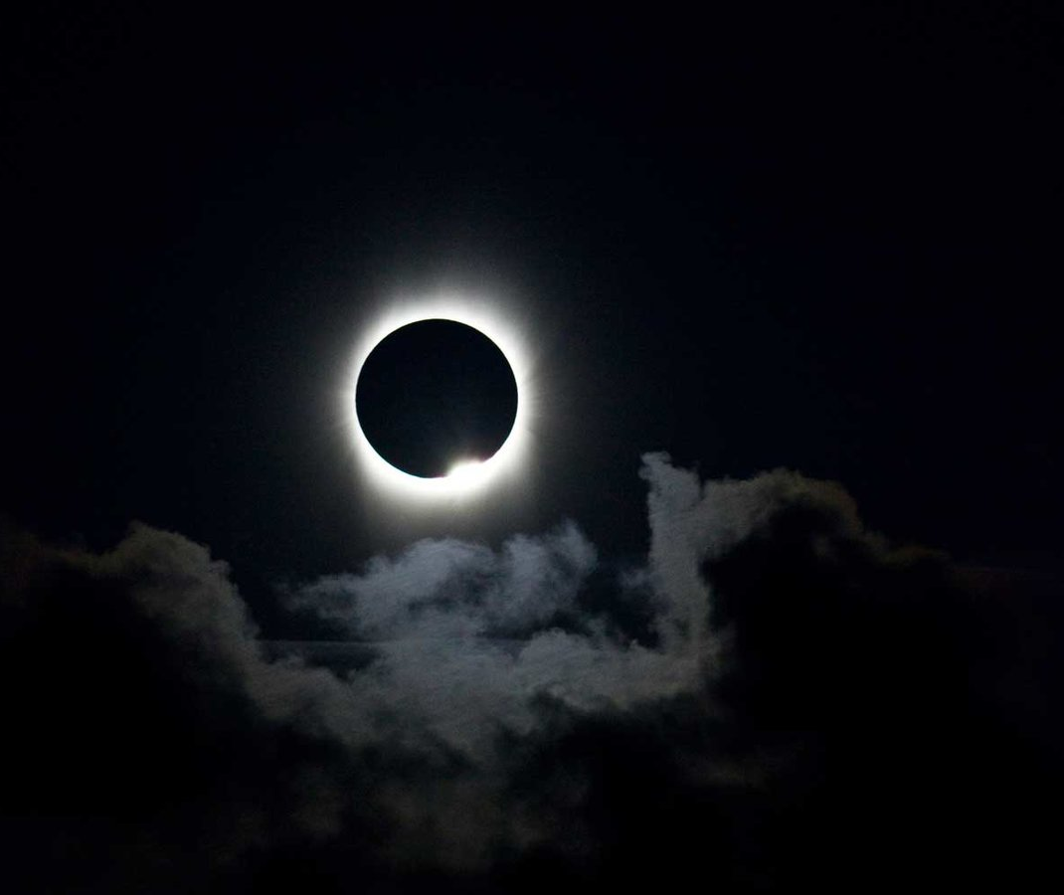
Aug 21
5 pm
6 pm
Aug 21
Today
17:18
17:43
18:05
18:26
18:47
Salem, Oregon
Casper, Wyoming
Sabetha, Kansas
Hopkinsville, Kentuky
Charleston, South Carolina
17:33
18:03
18:21
18:43
Idaho Falls, Idaho
Lincoln, Nebraska
Carbondale, Illinois
Columbia, South Carolina
18:37
Clayton, Georgia
18:28
Nashville, Tennessee
18:14
Jefferson City, Missouri

